Slide 1
Image Clustering
Dr. Rafiqul Islam

Slide 2
Clustering
Clustering is basically an Unsupervised learning method
that divides the data points into a number of specific batches or groups,
such that the data points in the same groups have similar properties and
data points in different groups have different properties in some sense.

Slide 3
Clustering Algorithm
K-Means
DBSCAN (Density-based spatial clustering of applications with noise)

Slide 4
K-Means Clustering Algorithm
K-Means algorithm works based on distance between points.
The algorithm categorizes the items into k groups of similarity.
To calculate that similarity, the Euclidean distance is used as measurement.

Slide 5
K-Means Clustering Algorithm
K-Means algorithm Steps
First initialize k points, called means, randomly.
Categorize each item to its closest mean and update the mean’s coordinates, which are the averages of the items categorized in that mean so far.
Repeat the process for a given number of iterations and at the end, we have our clusters.

Slide 6
K-Means Clustering Algorithm
K-Means algorithm Steps
Specify number of clusters K.
Initialize centroids by first shuffling the dataset and then randomly selecting K data points for the centroids without replacement.
Keep iterating until there is no change to the centroids. i.e assignment of data points to clusters isn’t changing.
Compute the sum of the squared distance between data points and all centroids.
Assign each data point to the closest cluster (centroid).
Compute the centroids for the clusters by taking the average of the all data points that belong to each cluster.

Slide 7
K-Means Clustering Algorithm
K-Means algorithm in Pseudocode
Initialize k means with random values
For a given number of iterations:
Iterate through items:
Find the mean closest to the item
Assign item to mean
Update mean
end

Slide 8
K-Means Clustering Algorithm
K-Means algorithm in Example

Slide 9
K-Means Clustering Algorithm
Disadvantages of K-Means algorithm
K-Means forms spherical clusters only. This algorithm fails when data is not spherical ( i.e. same variance in all directions).
K-Means algorithm is sensitive towards outlier. Outliers can skew the clusters in K-Means in very large extent.
K-Means algorithm requires one to specify the number of clusters a priory etc.

Slide 10
DBSCAN Clustering Algorithm
DBSCAN (Density-based spatial clustering of applications with noise) works based on distance between nearest points.
DBSCAN algorithm identifies the dense region by grouping together data points that are closed to each other based on distance measurement.

Slide 11
Why DBSCAN Clustering Algorithm?
Partitioning methods (K-means, PAM clustering) and hierarchical clustering work for finding spherical-shaped clusters or convex clusters.
In other words, they are suitable only for compact and well-separated clusters.
Moreover, they are also severely affected by the presence of noise and outliers in the data.

Slide 12
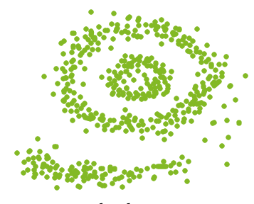
Why DBSCAN Clustering Algorithm?
Real life data may contain irregularities, like –
Clusters can be of arbitrary shape such as those shown in the figure below.
Data may contain noise.

Slide 13
DBSCAN Clustering Algorithm
DBSCAN algorithm requires two parameters
EPS: It defines the neighborhood around a data point i.e. if the distance between two points is lower or equal to ‘eps’ then they are considered as neighbors. If the eps value is chosen too small then large part of the data will be considered as outliers. If it is chosen very large then the clusters will merge and majority of the data points will be in the same clusters. One way to find the eps value is based on the k-distance graph.
Min Points (MinPts): Minimum number of neighbors (data points) within eps radius. Larger the dataset, the larger value of MinPts must be chosen.

Slide 14
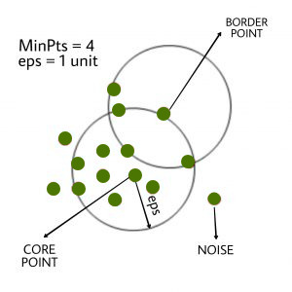
DBSCAN Clustering Algorithm
DBSCAN algorithm uses 3 types of data points
Core Point: A point is a core point if it has more than MinPts points within eps.
Border Point: A point which has fewer than MinPts within eps but it is in the neighborhood of a core point.
Noise or outlier: A point which is not a core point or border point.

Slide 15
DBSCAN Clustering Algorithm
DBSCAN algorithm can be abstracted as
Find all the neighbor points within eps and identify the core points or visited with more than MinPts neighbors.
For each core point if it is not already assigned to a cluster, create a new cluster.
Find recursively all its density connected points and assign them to the same cluster as the core point.
A point a and b are said to be density connected if there exist a point c which has a sufficient number of points in its neighbors and both the points a and b are within the eps distance. This is a chaining process. So, if b is neighbor of c, c is neighbor of d, d is neighbor of e, which in turn is neighbor of a implies that b is neighbor of a.
Iterate through the remaining unvisited points in the dataset. Those points that do not belong to any cluster are noise.

Slide 16
DBSCAN Clustering Algorithm

Slide 17
DBSCAN Clustering Algorithm
DBSCAN algorithm in pseudocode as
DBSCAN(dataset, eps, MinPts) {
# cluster index
C = 1
for each unvisited point p in dataset {
mark p as visited
# find neighbors
Neighbors N = find the neighboring points of p
if |N|>=MinPts:
N = N U N'
if p' is not a member of any cluster:
add p' to cluster C
}

Slide 18
DBSCAN Clustering Algorithm
Disadvantages of DBSCAN
If the database has data points that form clusters of varying density, then DBSCAN fails to cluster the data points well, since the clustering depends on EPS (ϵ) and MinPts parameter, they cannot be chosen separately for all clusters.
If the data and features are not so well understood by a domain expert then, setting up EPS (ϵ) and MinPts could be tricky and, may need comparisons for several iterations with different values of EPS (ϵ) and MinPts.

Slide 19
DBSCAN Clustering Algorithm

